Slide 1
How to Use this Presentation:
Double-check each slide carefully to be sure that all points are applicable to your plans.
Copy and paste the slides into your open enrollment presentation.
To increase your enrollment rate, we recommend that you present these slides after you discuss your medical, vision and dental plans.
If a slide has a video on it, simply click the video to open it in your browser.

Slide 2
Health Reimbursement Arrangement

Slide 3
What is an HRA?

Slide 4
Health Reimbursement Arrangement
A health reimbursement arrangement (HRA) is funded by your employer to help you pay for pre-determined medical expenses.

Slide 5
Health Reimbursement Arrangement
How much you can contribute:
What you can use it for:
Please fill in this section
Please fill in this section with eligible expenses

Slide 6
Health Reimbursement Arrangement
Things to note:
To be eligible to participate in the HRA, you must be enrolled in your company’s sponsored medical plan
The funds are made available to you at the beginning of the defined plan year
Since the HRA is employer funded, you as the employee will be required to submit documentation for an expense to identify the expense was allowed and within the employer’s parameters
Place Image Here

Slide 7
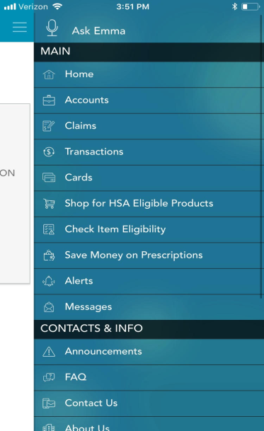
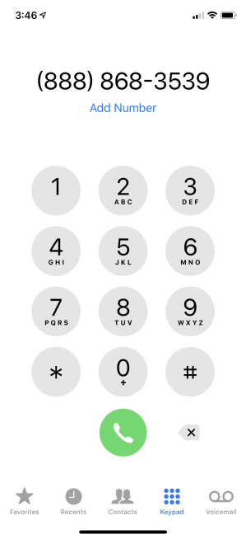
Ameriflex Support
Download the Mobile App
Call Us at
888.868.3539
Visit
www.myameriflex.com

Slide 8
Questions?

